Slide 1


Slide 2
Story
The objective of this project is to develop a database on Mobile Shop Management System. From this project we can get a clear idea about how the database works and how we can use this.
“The Mobile Shop Management System” is one can go into almost required solution regarding the Mobile shop.
There are various type of tables available to manage PaymentBill, Purchase, Customers, Mobiles etc.

Slide 3
Story
The details of Mobile is store into the Mobile tables respective with all tables.
Each table( stock, supplier, customer, employee, paymentBill, purchase, mobile) contains primary key.
There is one-to-one and one-to-many relations available between customer, paymentBill, purchase, stock, mobile.
We have implemented indexing on each tables of Mobile Shop Management System tables for fast query execution.

Slide 4
Scope
The scope of this project is to provide a realistic experience in the conceptual design, logical design, implementation, operation, and maintenance of a relational database.
The project could be implemented in an implemented in an average sized organization.
The data is directly stored in database in the hard disk of the Pc.

Slide 5
Mobile Shop Management System Tables and their attributes
mobiles table: Attributes of mobiles are company_name, company_series, model_no, imei_number, ram, rom, display_size, display_quality, processor, battery_capacity, color, price.
employee table: Attributes of employee are em_id, em_name, em_contactNumber, em_email, em_address, em_salary.
customer table: Attributes of customersare c_id, c_name, c_email, c_contactNumber, c_address.
stock table: Attributes of stocks are s_id, room_number, mobile_imei_number.
purchase table: Attributes of purchase are customer_id, purchase_mobile_imei_no, purchase_date, paid_amount.
paymentBill Table: Attributes of paymentBill are pb_id, pb_date, customer_id, customer_name, customer_contact_no, mobile_imei_no, mobile_price, paid_amount.
supplier table: Attributes of supplier are s_id, s_name, s_contact_no, s_address, supply_mobile_imei_no, total_supply.

Slide 6
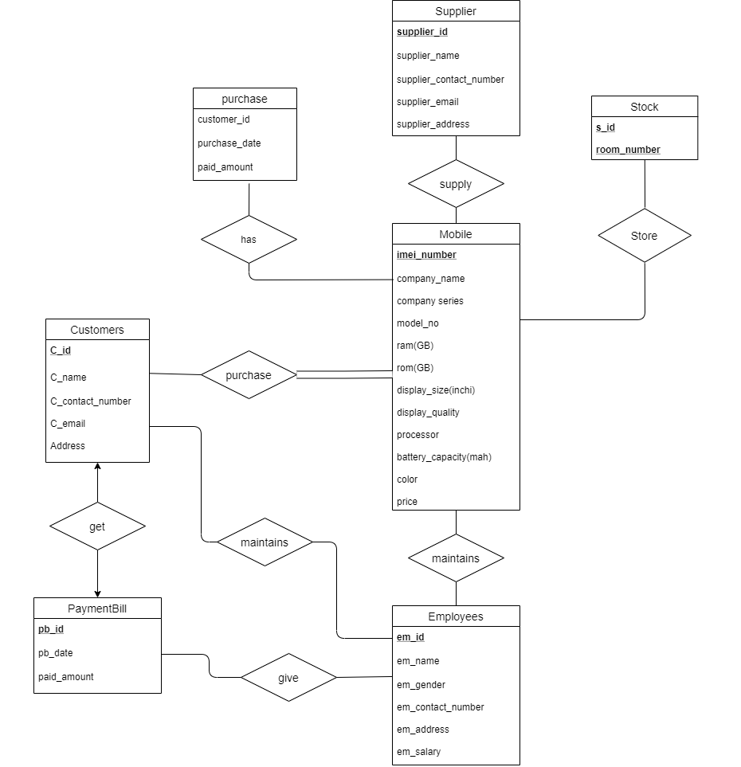
ER Diagram

Slide 7
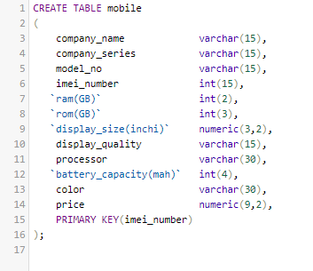
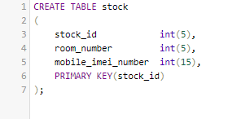
Appendix
CREATE DATABASE mobile_shop_management_system;

Slide 8
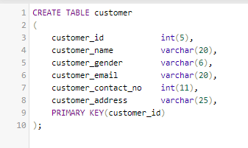
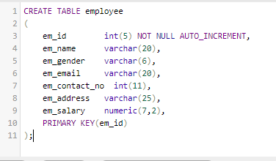
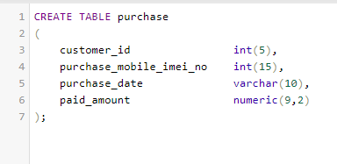

Slide 9
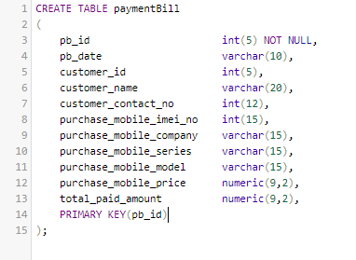
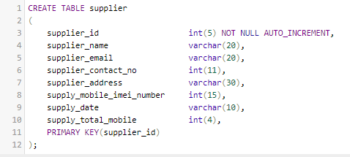

Slide 10
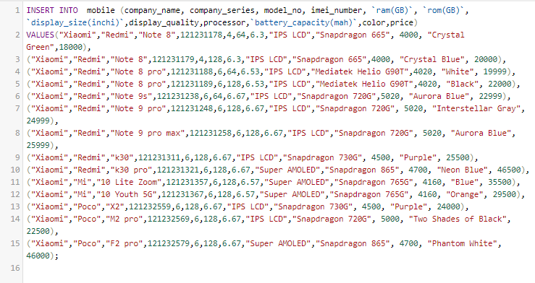
Data Insert

Slide 11
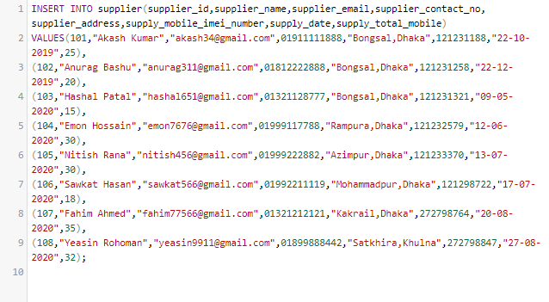
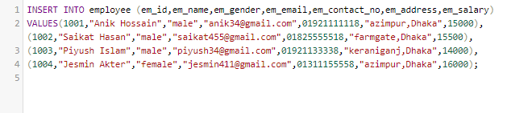

Slide 12
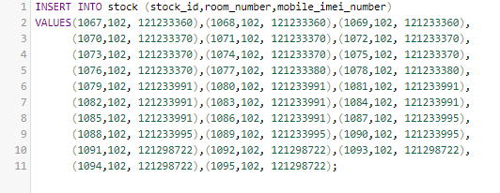
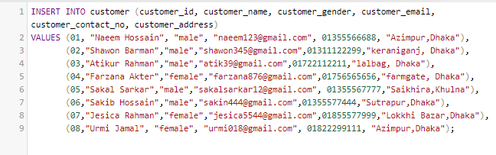
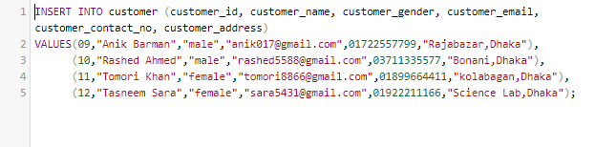

Slide 13
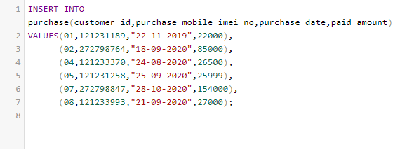
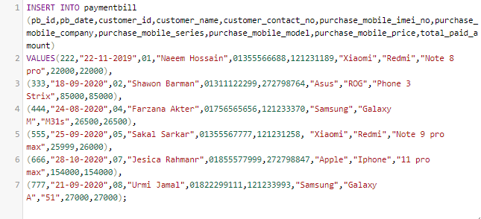

Slide 14
Thank You

